Slide 1
Chapter 4: Network Layer
Chapter goals:
understand principles behind network layer services:
  routing (path selection)
  dealing with scale
  how a router works
  advanced topics: IPv6, multicast
instantiation and implementation in the Internet
Overview:
network layer services
routing principle: path selection
hierarchical routing
IP
Internet routing protocols reliable transfer
  intra-domain
  inter-domain
what’s inside a router?
IPv6
multicast routing
4: Network Layer
4a-<number>

Slide 2





Network layer functions
transport packet from sending to receiving hosts
network layer protocols in every host, router
three important functions:
path determination: route taken by packets from source to dest. Routing algorithms
switching: move packets from router’s input to appropriate router output
call setup: some network architectures require router call setup along path before data flows
application
transport
network
data link
physical
network
data link
physical
network
data link
physical
network
data link
physical
network
data link
physical
network
data link
physical
network
data link
physical
network
data link
physical
network
data link
physical
application
transport
network
data link
physical
4: Network Layer
4a-<number>

Slide 3
Network service model
Q: What service model for “channel” transporting packets from sender to receiver?
guaranteed bandwidth?
preservation of inter-packet timing (no jitter)?
loss-free delivery?
in-order delivery?
congestion feedback to sender?
The most important
abstraction provided
by network layer:
?
?
virtual circuit
or
datagram?
?
service abstraction
4: Network Layer
4a-<number>

Slide 4
Virtual circuits
“source-to-dest path behaves much like telephone circuit”
  performance-wise
  network actions along source-to-dest path
call setup, teardown for each call before data can flow
each packet carries VC identifier (not destination host OD)
every router on source-dest path s maintain “state” for each passing connection
  transport-layer connection only involved two end systems
link, router resources (bandwidth, buffers) may be allocated to VC
  to get circuit-like perf.
4: Network Layer
4a-<number>

Slide 5
Virtual circuits: signaling protocols
used to setup, maintain teardown VC
used in ATM, frame-relay, X.25
not used in today’s Internet
application
transport
network
data link
physical
5. Data flow begins
6. Receive data
application
transport
network
data link
physical
4. Call connected
3. Accept call
1. Initiate call
2. incoming call
4: Network Layer
4a-<number>

Slide 6
Datagram networks: the Internet model
no call setup at network layer
routers: no state about end-to-end connections
  no network-level concept of “connection”
packets typically routed using destination host ID
  packets between same source-dest pair may take different paths
application
transport
network
data link
physical
application
transport
network
data link
physical
1. Send data
2. Receive data
4: Network Layer
4a-<number>

Slide 7
Network layer service models:
Network
Architecture
Internet
ATM
ATM
ATM
ATM
Service
Model
best effort
CBR
VBR
ABR
UBR
Guarantees ?
Congestion
feedback
no (inferred
via loss)
no
congestion
no
congestion
yes
no
Bandwidth
none
constant
rate
guaranteed
rate
guaranteed
minimum
none
Loss
no
yes
yes
no
no
Order
no
yes
yes
yes
yes
Timing
no
yes
yes
no
no
Internet model being extented: Intserv, Diffserv
  Chapter 6
4: Network Layer
4a-<number>

Slide 8
Datagram or VC network: why?
Internet
data exchange among computers
  “elastic” service, no strict timing req.
“smart” end systems (computers)
  can adapt, perform control, error recovery
  simple inside network, complexity at “edge”
many link types
  different characteristics
  uniform service difficult
ATM
evolved from telephony
human conversation:
  strict timing, reliability requirements
  need for guaranteed service
“dumb” end systems
  telephones
  complexity inside network
4: Network Layer
4a-<number>

Slide 9
Routing
Routing protocol
Goal: determine “good” path
(sequence of routers) thru
network from source to dest.
5
B
3
C
2
5
A
2
1
F
Graph abstraction for routing algorithms:
graph nodes are routers
graph edges are physical links
  link cost: delay, $ cost, or congestion level
3
1
2
D
E
1
“good” path:
  typically means minimum cost path
  other def’s possible
4: Network Layer
4a-<number>

Slide 10
Routing Algorithm classification
Global or decentralized information?
Global:
all routers have complete topology, link cost info
“link state” algorithms
Decentralized:
router knows physically-connected neighbors, link costs to neighbors
iterative process of computation, exchange of info with neighbors
“distance vector” algorithms
Static or dynamic?
Static:
routes change slowly over time
Dynamic:
routes change more quickly
  periodic update
  in response to link cost changes
4: Network Layer
4a-<number>

Slide 11
A Link-State Routing Algorithm
Dijkstra’s algorithm
net topology, link costs known to all nodes
  accomplished via “link state broadcast”
  all nodes have same info
computes least cost paths from one node (‘source”) to all other nodes
  gives routing table for that node
iterative: after k iterations, know least cost path to k dest.’s
Notation:
c(i,j): link cost from node i to j. cost infinite if not direct neighbors
D(v): current value of cost of path from source to dest. V
p(v): predecessor node along path from source to v, that is next v
N: set of nodes whose least cost path definitively known
4: Network Layer
4a-<number>

Slide 12
Dijsktra’s Algorithm
1 Initialization:
2 N = {A}
3 for all nodes v
4 if v adjacent to A
5 then D(v) = c(A,v)
6 else D(v) = infty
7
8 Loop
9 find w not in N such that D(w) is a minimum
10 add w to N
11 update D(v) for all v adjacent to w and not in N:
12 D(v) = min( D(v), D(w) + c(w,v) )
13 /* new cost to v is either old cost to v or known
14 shortest path cost to w plus cost from w to v */
15 until all nodes in N
4: Network Layer
4a-<number>

Slide 13
Dijkstra’s algorithm: example
Step
0
1
2
3
4
5
start N
A
AD
ADE
ADEB
ADEBC
ADEBCF
D(B),p(B)
2,A
2,A
2,A
D(C),p(C)
5,A
4,D
3,E
3,E
D(D),p(D)
1,A
D(E),p(E)
infinity
2,D
D(F),p(F)
infinity
infinity
4,E
4,E
4,E
5
B
3
C
2
5
A
2
1
F
3
1
2
D
E
1
4: Network Layer
4a-<number>

Slide 14
Dijkstra’s algorithm, discussion
Algorithm complexity: n nodes
each iteration: need to check all nodes, w, not in N
n*(n+1)/2 comparisons: O(n**2)
more efficient implementations possible: O(nlogn)
Oscillations possible:
e.g., link cost = amount of carried traffic
1
A
A
A
A
1+e
2+e
0
0
2+e
2+e
0
D
0
0
B
D
B
D
B
D
B
1+e
1
0
0
1+e
1
0
e
0
0
1
1+e
0
e
C
C
C
C
1
1
e
… recompute
routing
… recompute
… recompute
initially
4: Network Layer
4a-<number>

Slide 15
Distance Vector Routing Algorithm
iterative:
continues until no nodes exchange info.
self-terminating: no “signal” to stop
asynchronous:
nodes need not exchange info/iterate in lock step!
distributed:
each node communicates only with directly-attached neighbors
Distance Table data structure
each node has its own
row for each possible destination
column for each directly-attached neighbor to node
example: in node X, for dest. Y via neighbor Z:
distance from X to
Y, via Z as next hop
X
=
D (Y,Z)
Z
=
c(X,Z) + min {D (Y,w)}
w
4: Network Layer
4a-<number>

Slide 16
Distance Table: example
1
cost to destination via
B
C
E
7
D ()
A
B
C
D
A
1
7
6
4
B
14
8
9
11
D
5
5
4
2
A
8
2
1
E
D
2
E
D
D (C,D)
=
c(E,D) + min {D (C,w)}
destination
w
=
2+2 = 4
E
D
D (A,D)
=
c(E,D) + min {D (A,w)}
w
=
2+3 = 5
loop!
E
B
D (A,B)
=
c(E,B) + min {D (A,w)}
w
=
8+6 = 14
loop!
4: Network Layer
4a-<number>

Slide 17
Distance table gives routing table
cost to destination via
E
Outgoing link
to use, cost
D ()
A
B
C
D
A
1
7
6
4
B
14
8
9
11
D
5
5
4
2
A
B
C
D
A,1
D,5
D,4
D,4
destination
destination
Distance table
Routing table
4: Network Layer
4a-<number>

Slide 18
Distance Vector Routing: overview
Iterative, asynchronous: each local iteration caused by:
local link cost change
message from neighbor: its least cost path change from neighbor
Distributed:
each node notifies neighbors only when its least cost path to any destination changes
  neighbors then notify their neighbors if necessary
Each node:
wait for (change in local link cost of msg from neighbor)
recompute distance table
if least cost path to any dest has changed, notify neighbors
4: Network Layer
4a-<number>

Slide 19
Distance Vector Algorithm:
At all nodes, X:
1 Initialization:
2 for all adjacent nodes v:
3 D (*,v) = infty /* the * operator means "for all rows" */
4 D (v,v) = c(X,v)
5 for all destinations, y
6 send min D (y,w) to each neighbor /* w over all X's neighbors */
X
X
X
w
4: Network Layer
4a-<number>

Slide 20
Distance Vector Algorithm (cont.):
8 loop
9 wait (until I see a link cost change to neighbor V
10 or until I receive update from neighbor V)
11
12 if (c(X,V) changes by d)
13 /* change cost to all dest's via neighbor v by d */
14 /* note: d could be positive or negative */
15 for all destinations y: D (y,V) = D (y,V) + d
16
17 else if (update received from V wrt destination Y)
18 /* shortest path from V to some Y has changed */
19 /* V has sent a new value for its min DV(Y,w) */
20 /* call this received new value is "newval" */
21 for the single destination y: D (Y,V) = c(X,V) + newval
22
23 if we have a new min D (Y,w)for any destination Y
24 send new value of min D (Y,w) to all neighbors
25
26 forever
X
X
w
X
X
w
X
w
4: Network Layer
4a-<number>

Slide 21
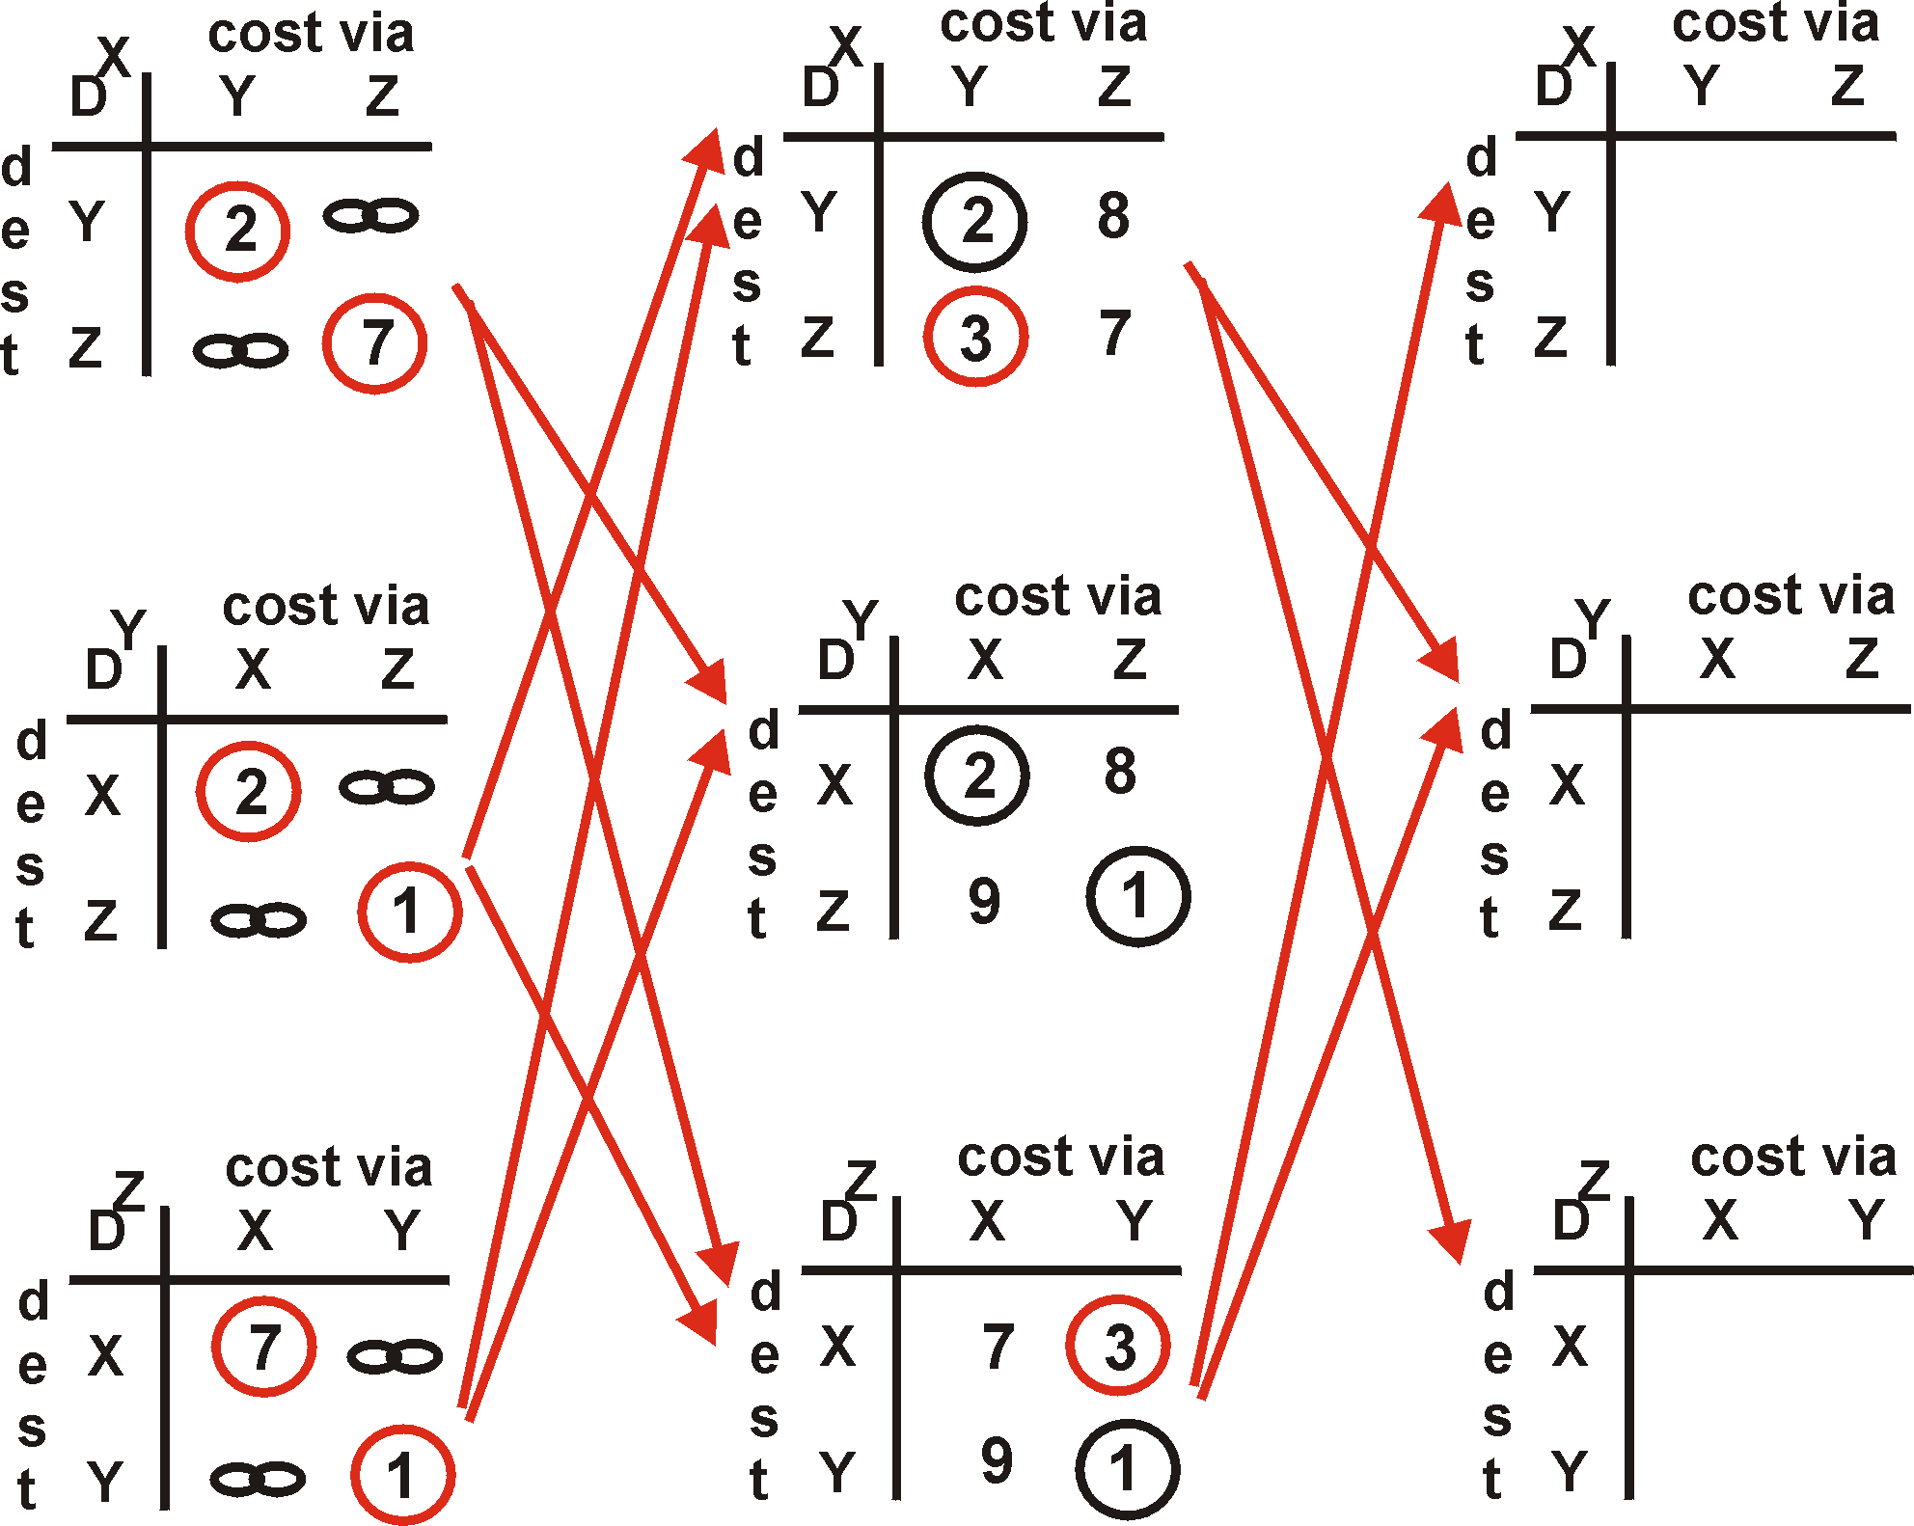
Distance Vector Algorithm: example
Y
2
1
X
Z
7
4: Network Layer
4a-<number>

Slide 22
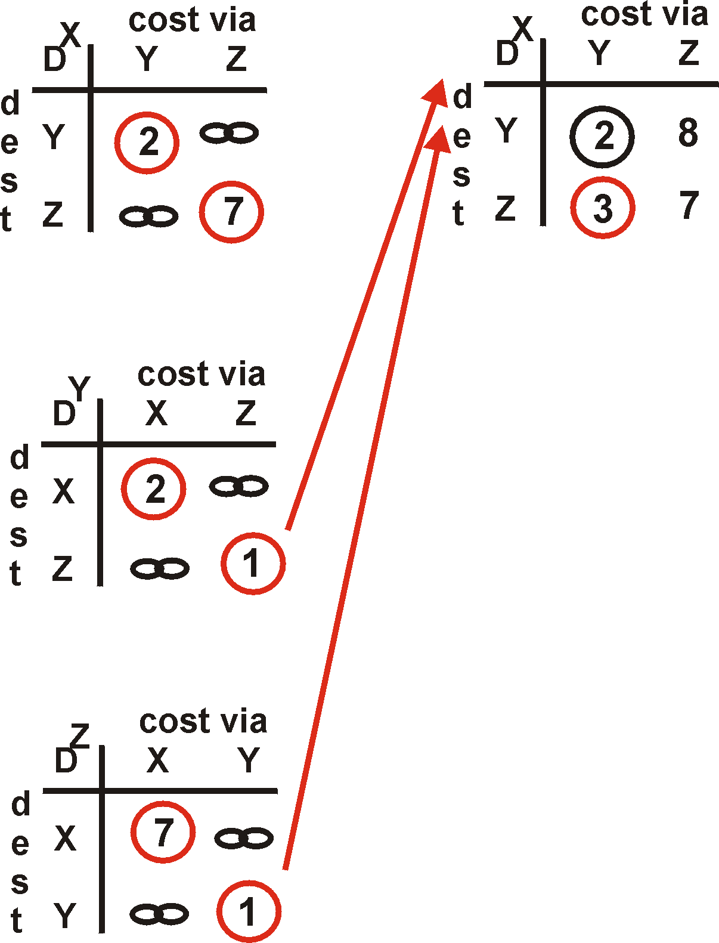
Distance Vector Algorithm: example
Y
2
1
X
Z
X
Z
7
D (Y,Z)
=
c(X,Z) + min {D (Y,w)}
w
=
7+1 = 8
X
Y
D (Z,Y)
=
c(X,Y) + min {D (Z,w)}
w
=
2+1 = 3
4: Network Layer
4a-<number>

Slide 23
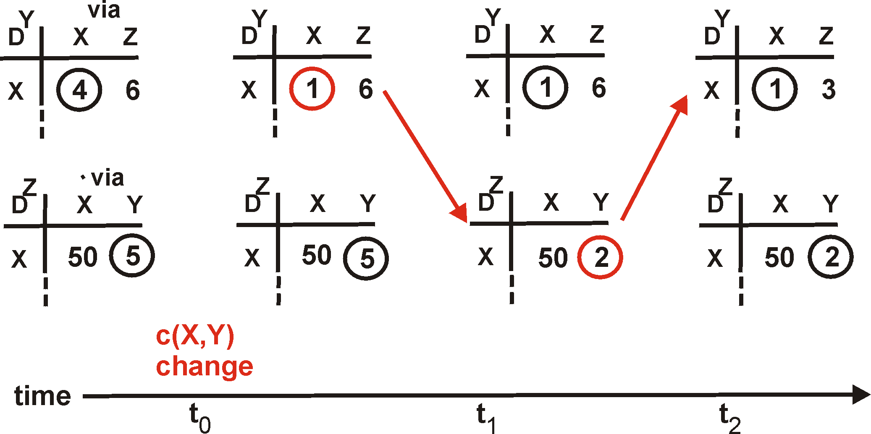
Distance Vector: link cost changes
Link cost changes:
node detects local link cost change
updates distance table (line 15)
if cost change in least cost path, notify neighbors (lines 23,24)
1
Y
4
1
X
Z
50
algorithm
terminates
“good
news
travels
fast”
4: Network Layer
4a-<number>

Slide 24
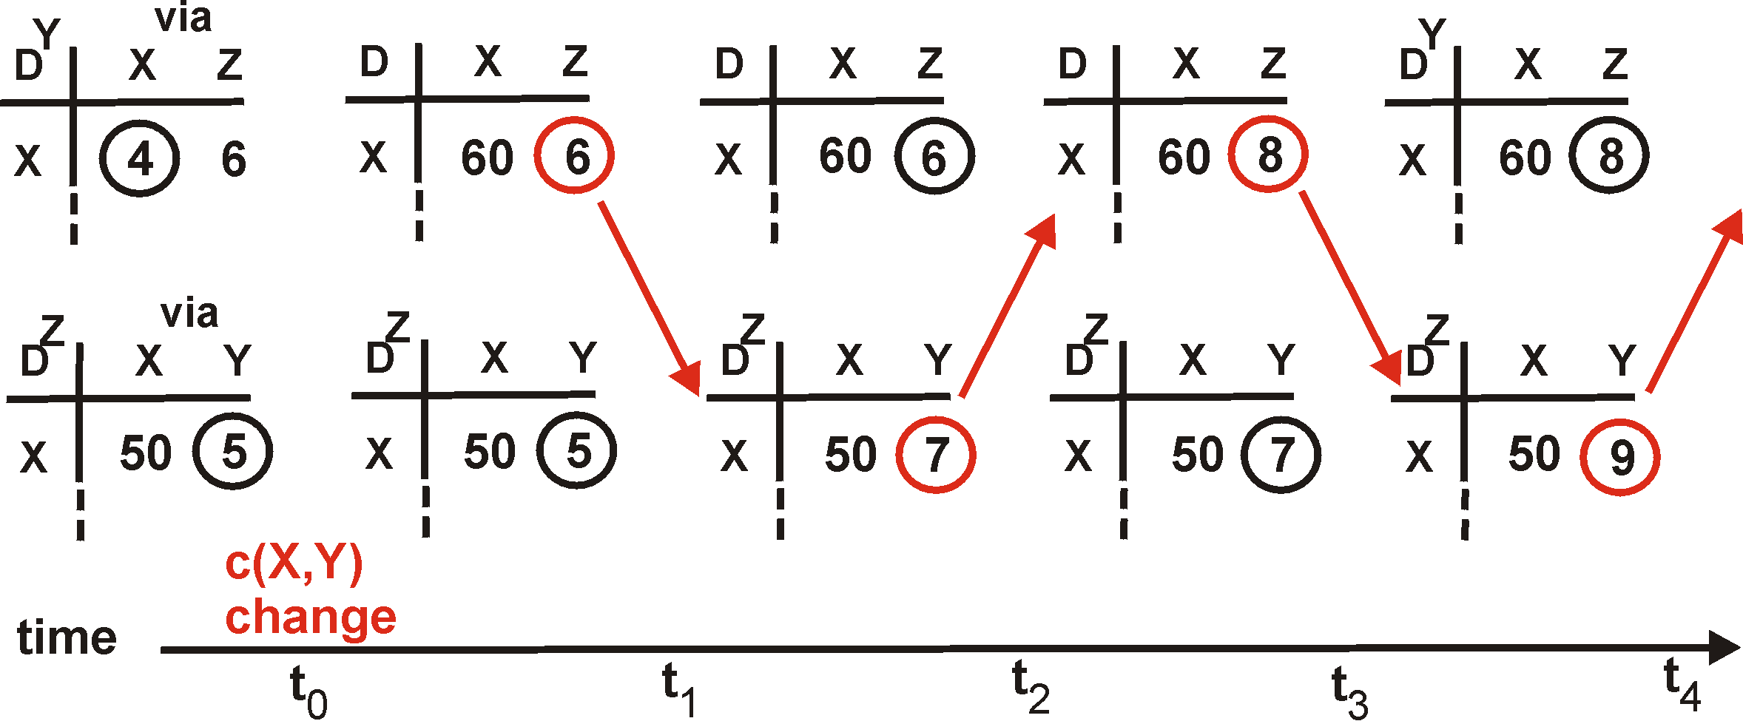
Distance Vector: link cost changes
Link cost changes:
good news travels fast
bad news travels slow - “count to infinity” problem!
60
Y
4
1
X
Z
50
algorithm
continues
on!
4: Network Layer
4a-<number>

Slide 25
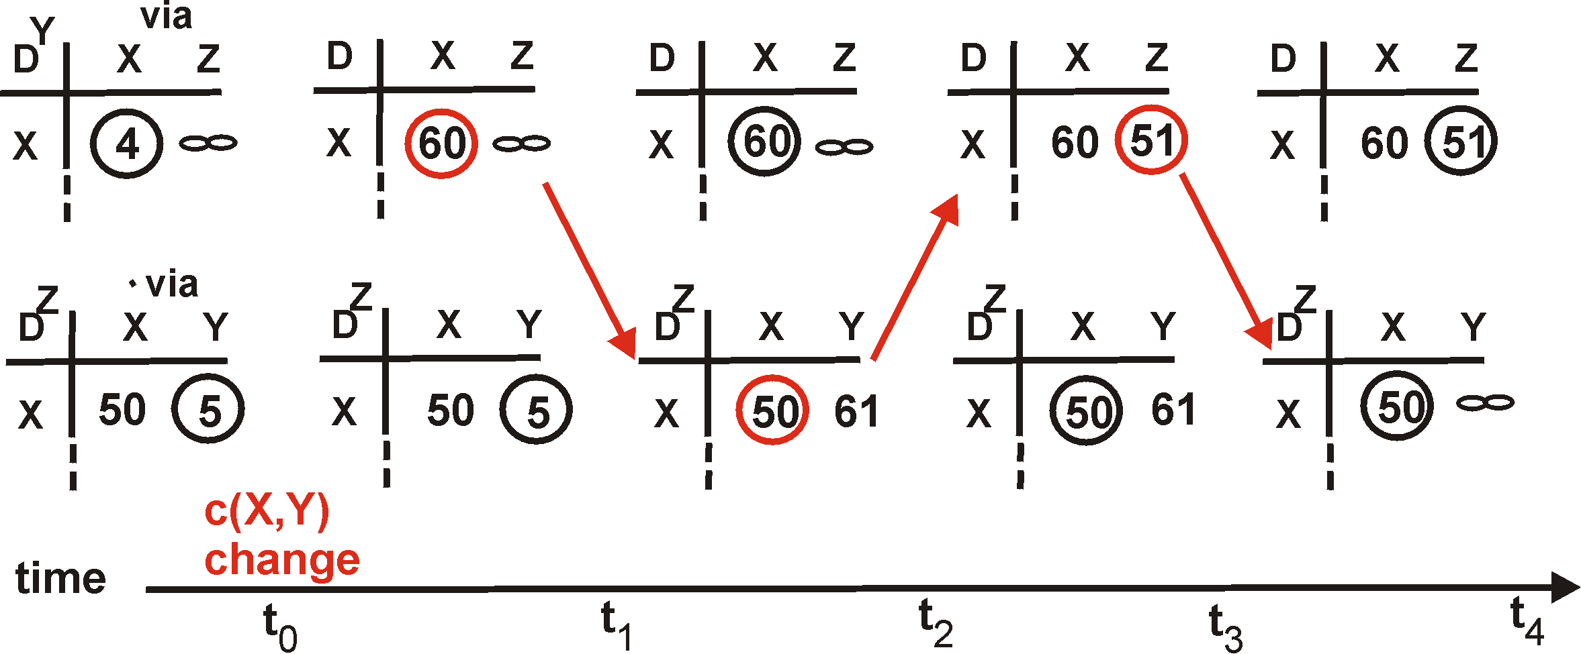
Distance Vector: poisoned reverse
If Z routes through Y to get to X :
Z tells Y its (Z’s) distance to X is infinite (so Y won’t route to X via Z)
will this completely solve count to infinity problem?
60
Y
4
1
X
Z
50
algorithm
terminates
4: Network Layer
4a-<number>

Slide 26
Comparison of LS and DV algorithms
Message complexity
LS: with n nodes, E links, O(nE) msgs sent each
DV: exchange between neighbors only
  convergence time varies
Speed of Convergence
LS: O(n**2) algorithm requires O(nE) msgs
  may have oscillations
DV: convergence time varies
  may be routing loops
  count-to-infinity problem
Robustness: what happens if router malfunctions?
LS:
  node can advertise incorrect link cost
  each node computes only its own table
DV:
  DV node can advertise incorrect path cost
  each node’s table used by others
    error propagate thru network
4: Network Layer
4a-<number>

Slide 27
Hierarchical Routing
Our routing study thus far - idealization
all routers identical
network “flat”
… not true in practice
scale: with 50 million destinations:
can’t store all dest’s in routing tables!
routing table exchange would swamp links!
administrative autonomy
internet = network of networks
each network admin may want to control routing in its own network
4: Network Layer
4a-<number>

Slide 28
Hierarchical Routing
aggregate routers into regions, “autonomous systems” (AS)
routers in same AS run same routing protocol
  “intra-AS” routing protocol
  routers in different AS can run different intra-AS routing protocol
gateway routers
special routers in AS
run intra-AS routing protocol with all other routers in AS
also responsible for routing to destinations outside AS
  run inter-AS routing protocol with other gateway routers
4: Network Layer
4a-<number>

Slide 29
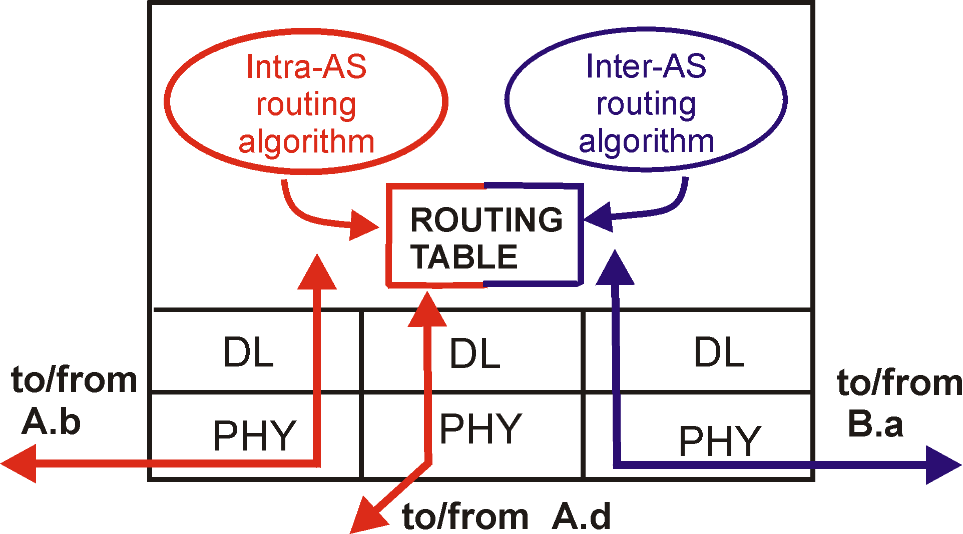
Intra-AS and Inter-AS routing
C.b
Gateways:
  perform inter-AS routing amongst themselves
  perform intra-AS routers with other routers in their AS
B.a
A.a
b
A.c
c
a
C
a
b
a
B
d
c
A
b
network layer
inter-AS, intra-AS routing in
gateway A.c
link layer
physical layer
4: Network Layer
4a-<number>

Slide 30
Intra-AS and Inter-AS routing
Inter-AS
routing
between
A and B
C.b
B.a
A.a
Host
h2
b
A.c
c
a
C
a
b
a
B
Host
h1
d
c
Intra-AS routing
within AS B
A
b
Intra-AS routing
within AS A
We’ll examine specific inter-AS and intra-AS Internet routing protocols shortly
4: Network Layer
4a-<number>

Slide 31
The Internet Network layer
Host, router network layer functions:
Transport layer: TCP, UDP
Routing protocols
path selection
RIP, OSPF, BGP
IP protocol
addressing conventions
datagram format
packet handling conventions
Network
layer
routing
table
ICMP protocol
error reporting
router “signaling”
Link layer
physical layer
4: Network Layer
4a-<number>

Slide 32
IP Addressing: introduction
IP address: 32-bit identifier for host, router interface
interface: connection between host, router and physical link
  router’s typically have multiple interfaces
  host may have multiple interfaces
  IP addresses associated with interface, not host, router
223.1.1.1
223.1.2.1
223.1.1.2
223.1.1.4
223.1.2.9
223.1.2.2
223.1.1.3
223.1.3.27
223.1.3.1
223.1.3.2
223.1.1.1 = 11011111 00000001 00000001 00000001
223
1
1
1
4: Network Layer
4a-<number>

Slide 33
IP Addressing
IP address:
  network part (high order bits)
  host part (low order bits)
What’s a network ? (from IP address perspective)
  device interfaces with same network part of IP address
  can physically reach each other without intervening router
223.1.1.1
223.1.2.1
223.1.1.2
223.1.1.4
223.1.2.9
223.1.2.2
223.1.1.3
223.1.3.27
LAN
223.1.3.1
223.1.3.2
network consisting of 3 IP networks
(for IP addresses starting with 223,
first 24 bits are network address)
4: Network Layer
4a-<number>

Slide 34
IP Addressing
How to find the networks?
Detach each interface from router, host
create “islands of isolated networks
223.1.1.1
223.1.1.2
223.1.1.4
223.1.1.3
223.1.9.2
223.1.7.0
223.1.9.1
223.1.7.1
223.1.8.1
223.1.8.0
223.1.2.6
223.1.3.27
Interconnected
system consisting
of six networks
223.1.2.1
223.1.2.2
223.1.3.1
223.1.3.2
4: Network Layer
4a-<number>

Slide 35
IP Addresses
given notion of “network”, let’s re-examine IP addresses:
“class-full” addressing:
class
A
network
1.0.0.0 to
127.255.255.255
0
host
B
10
network
host
128.0.0.0 to
191.255.255.255
C
110
network
host
192.0.0.0 to
223.255.255.255
D
1110
multicast address
224.0.0.0 to
239.255.255.255
32 bits
4: Network Layer
4a-<number>

Slide 36
IP addressing: CIDR
classful addressing:
  inefficient use of address space, address space exhaustion
  e.g., class B net allocated enough addresses for 65K hosts, even if only 2K hosts in that network
CIDR: Classless InterDomain Routing
  network portion of address of arbitrary length
  address format: a.b.c.d/x, where x is # bits in network portion of address
network
part
host
part
11001000 00010111 00010000 00000000
200.23.16.0/23
4: Network Layer
4a-<number>

Slide 37
IP addresses: how to get one?
Hosts (host portion):
hard-coded by system admin in a file
DHCP: Dynamic Host Configuration Protocol: dynamically get address: “plug-and-play”
  host broadcasts “DHCP discover” msg
  DHCP server responds with “DHCP offer” msg
  host requests IP address: “DHCP request” msg
  DHCP server sends address: “DHCP ack” msg
4: Network Layer
4a-<number>

Slide 38
IP addresses: how to get one?
Network (network portion):
get allocated portion of ISP’s address space:
ISP's block 11001000 00010111 00010000 00000000 200.23.16.0/20
Organization 0 11001000 00010111 00010000 00000000 200.23.16.0/23
Organization 1 11001000 00010111 00010010 00000000 200.23.18.0/23
Organization 2 11001000 00010111 00010100 00000000 200.23.20.0/23
... ….. …. ….
Organization 7 11001000 00010111 00011110 00000000 200.23.30.0/23
4: Network Layer
4a-<number>

Slide 39
Hierarchical addressing: route aggregation
Hierarchical addressing allows efficient advertisement of routing
information:
Organization 0
200.23.16.0/23
Organization 1
200.23.18.0/23
“Send me anything
with addresses
beginning
200.23.16.0/20”
Organization 2
200.23.20.0/23
.
Fly-By-Night-ISP
.
.
.
.
Internet
Organization 7
.
200.23.30.0/23
ISPs-R-Us
“Send me anything
with addresses
beginning
199.31.0.0/16”
4: Network Layer
4a-<number>

Slide 40
Hierarchical addressing: more specific routes
ISPs-R-Us has a more specific route to Organization 1
Organization 0
200.23.16.0/23
“Send me anything
with addresses
beginning
200.23.16.0/20”
Organization 2
200.23.20.0/23
.
Fly-By-Night-ISP
.
.
.
.
Internet
Organization 7
.
200.23.30.0/23
ISPs-R-Us
“Send me anything
with addresses
beginning 199.31.0.0/16
or 200.23.18.0/23”
Organization 1
200.23.18.0/23
4: Network Layer
4a-<number>

Slide 41
IP addressing: the last word...
Q: How does an ISP get block of addresses?
A: ICANN: Internet Corporation for Assigned
Names and Numbers
  allocates addresses
  manages DNS
  assigns domain names, resolves disputes
4: Network Layer
4a-<number>

Slide 42
Getting a datagram from source to dest.
routing table in A
Dest. Net. next router Nhops
223.1.1 1
223.1.2 223.1.1.4 2
IP datagram:
223.1.3 223.1.1.4 2
misc
fields
source
IP addr
dest
IP addr
data
A
223.1.1.1
datagram remains unchanged, as it travels source to destination
addr fields of interest here
223.1.2.1
223.1.1.2
223.1.1.4
223.1.2.9
B
223.1.2.2
E
223.1.1.3
223.1.3.27
223.1.3.1
223.1.3.2
4: Network Layer
4a-<number>

Slide 43
Getting a datagram from source to dest.
misc
fields
Dest. Net. next router Nhops
223.1.1.1
223.1.1.3
data
223.1.1 1
Starting at A, given IP datagram addressed to B:
look up net. address of B
find B is on same net. as A
link layer will send datagram directly to B inside link-layer frame
  B and A are directly connected
223.1.2 223.1.1.4 2
223.1.3 223.1.1.4 2
A
223.1.1.1
223.1.2.1
223.1.1.2
223.1.1.4
223.1.2.9
B
223.1.2.2
E
223.1.1.3
223.1.3.27
223.1.3.1
223.1.3.2
4: Network Layer
4a-<number>

Slide 44
Getting a datagram from source to dest.
misc
fields
Dest. Net. next router Nhops
223.1.1.1
223.1.2.3
data
223.1.1 1
Starting at A, dest. E:
look up network address of E
E on different network
  A, E not directly attached
routing table: next hop router to E is 223.1.1.4
link layer sends datagram to router 223.1.1.4 inside link-layer frame
datagram arrives at 223.1.1.4
continued…..
223.1.2 223.1.1.4 2
223.1.3 223.1.1.4 2
A
223.1.1.1
223.1.2.1
223.1.1.2
223.1.1.4
223.1.2.9
B
223.1.2.2
E
223.1.1.3
223.1.3.27
223.1.3.1
223.1.3.2
4: Network Layer
4a-<number>

Slide 45
Getting a datagram from source to dest.
Dest. next
misc
fields
network router Nhops interface
223.1.1.1
223.1.2.3
data
223.1.1 - 1 223.1.1.4
Arriving at 223.1.4, destined for 223.1.2.2
look up network address of E
E on same network as router’s interface 223.1.2.9
  router, E directly attached
link layer sends datagram to 223.1.2.2 inside link-layer frame via interface 223.1.2.9
datagram arrives at 223.1.2.2!!! (hooray!)
223.1.2 - 1 223.1.2.9
223.1.3 - 1 223.1.3.27
A
223.1.1.1
223.1.2.1
223.1.1.2
223.1.1.4
223.1.2.9
B
223.1.2.2
E
223.1.1.3
223.1.3.27
223.1.3.1
223.1.3.2
4: Network Layer
4a-<number>

